Slide 1
METAVERSE -THE NEW REALITY
By:
DHIRAJ WADILE
23361
SE 11

Slide 2
TABLE OF CONTENTS
1.Overview of Metaverse
2.History
3.Progress in Metaverse
4.Application of Metaverse in video game industry
5.Future of Metaverse
6.Pros and Cons of Metaverse
7.References

Slide 3
01. OVERVIEW

Slide 4
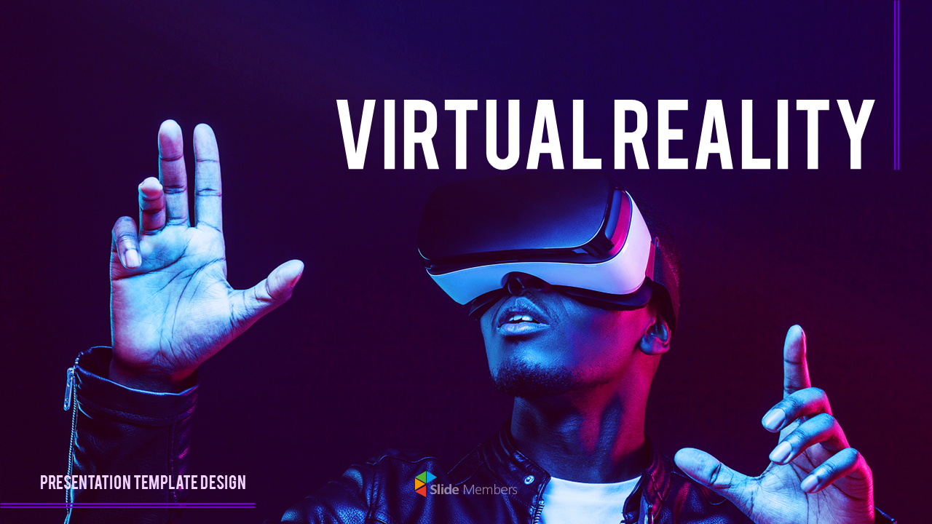
WHAT IS VIRTUAL REALITY?
1. Virtual reality is the use of computer technology to create simulated environments.
2. Virtual reality places the user inside a three-dimensional experience.
3. Instead of viewing a screen in front of them, users are immersed in and interact with 3D worlds.
4. Simulation of all five human senses transforms a computer into a vehicle into new worlds.

Slide 5
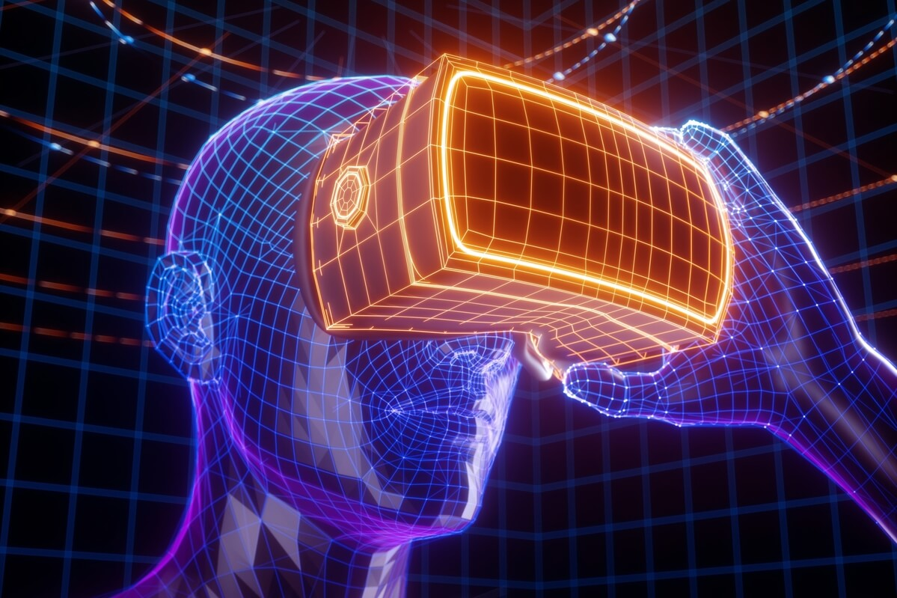
WHAT IS METAVERSE?
Metaverse is a virtual-reality space in which users can interact with a computer-generated environment and other users.
The internet will eventually evolve into the metaverse, which will to represent the next major computing platform.
Metaverse is an application of “Virtual Reality” concept.

Slide 6
02. HISTORY

Slide 7
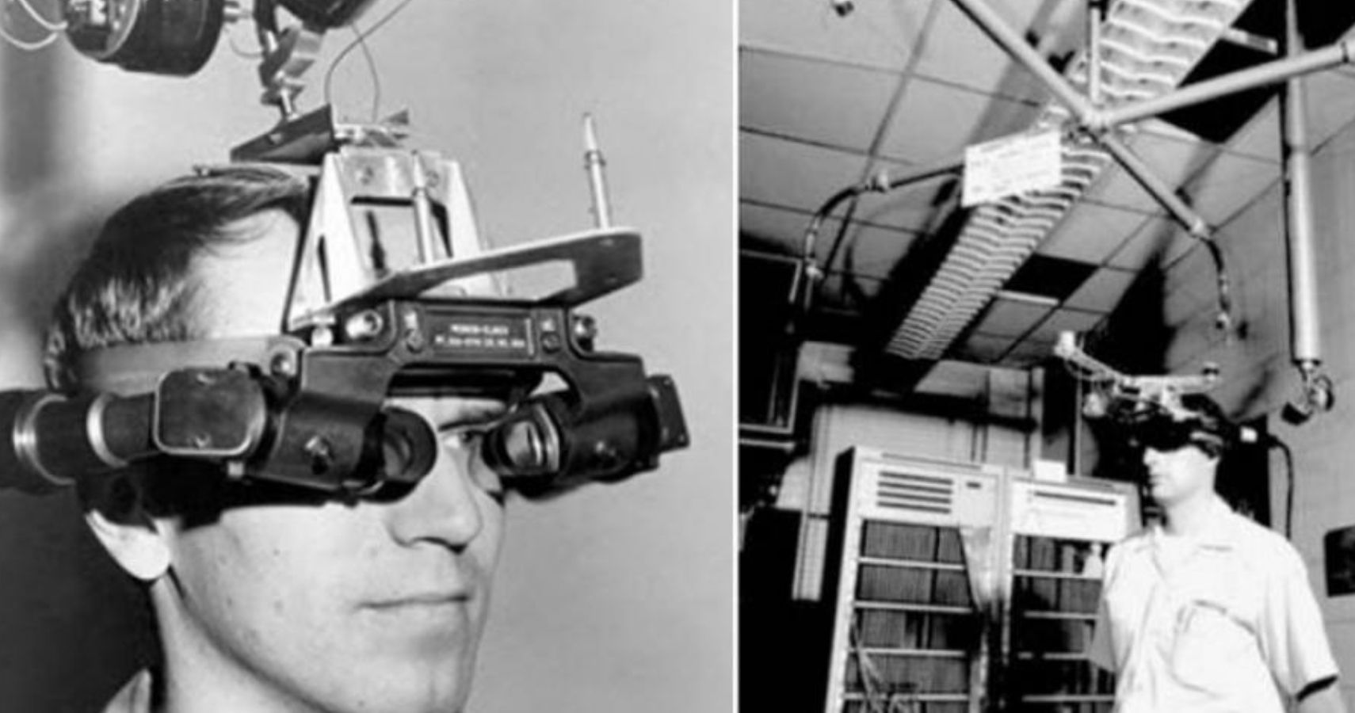
HISTORY OF METAVERSE
Morton Heilig created the first VR machine,”SENSORMA” in 1956. This machine simulated the experience of riding a motorcycle in Brooklyn by combining 3DVideo with audio, scents, and a vibrating chair to immerse the viewer.
In 1970s, MIT created the Aspen Movie Map, which enabled users to take a computer- generated tour of the town of Aspen, Colorado. This was the first time we could use VR to transport users to another place.
The term “METAVERSE” was first used by writer Neil Stevenson in his novel named “SNOW CRASH” to define a virtual reality to which characters can escape from real world.

Slide 8
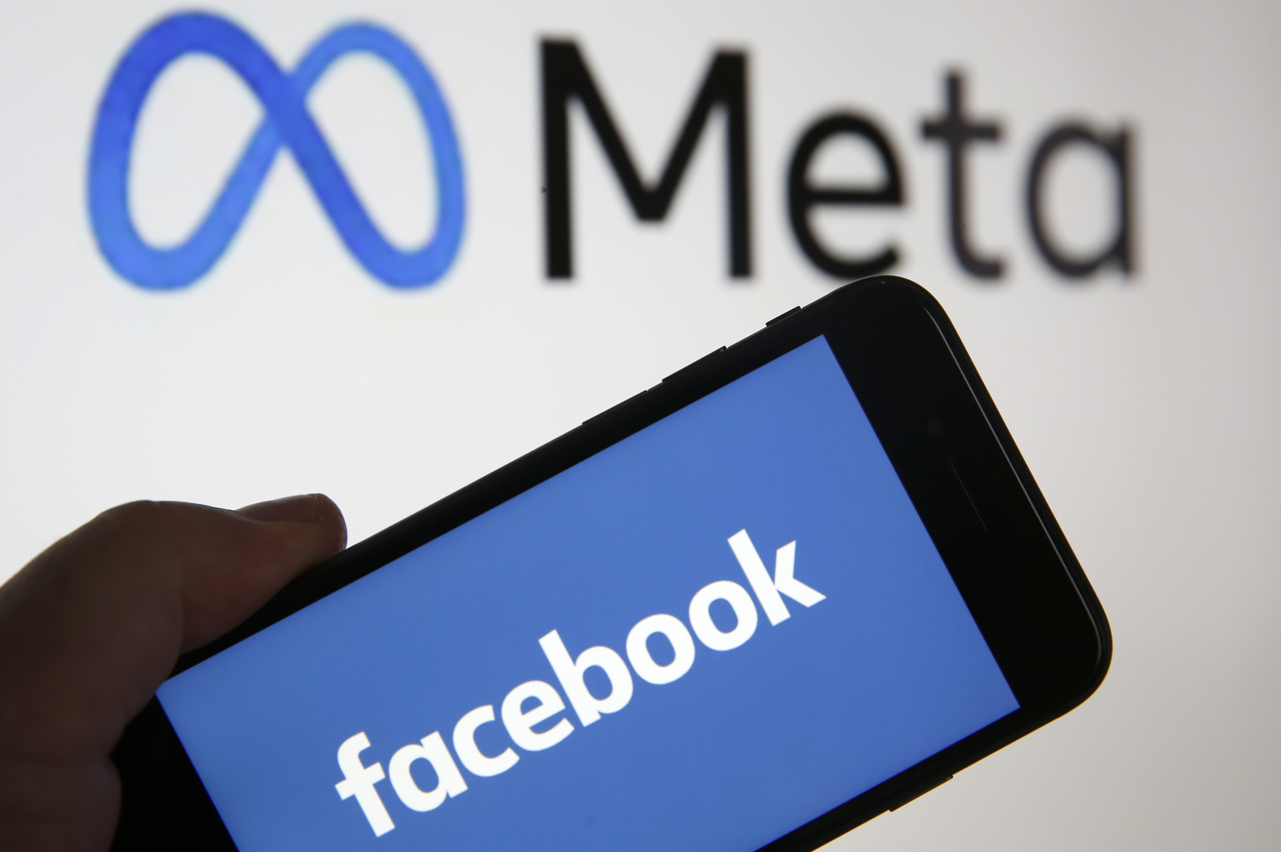
HISTORY OF METAVERSE
Facebook acquired Oculus VR in 2014 in a $2 billion deal. At that time, Facebook founder Mark Zuckerberg stated that Facebook and Oculus would work together to build out the Oculus platform and develop partnerships to support more games.
Also in 2014-a busy year for XR-Sony and Samsung both announced they were creating their own VR headsets, and Google released its first Cardboard device and Google Glass AR glasses. Google's Cardboard device is a low-cost cardboard VR viewer for smartphones.
Facebook changed its name to Meta in 2021, indicating its focus on shaping the future of the metaverse.
Also, Apple is currently working on headsets that could potentially replace our smartphones as the interface into the metaverse of the future.

Slide 9
WHAT CAN WE DO IN METAVERSE?
Own digital properties .
Earn money by investing in NFTs.
Play virtual games.
Attend concerts, trade shows, and learning events.
Make new friends.
Shop for real and virtual products.

Slide 10
03. PROGRESS IN METAVERSE

Slide 11
COMPANIES WORKING ON METAVERSE
MAIN COMPANIES:
Meta: The tech giant formerly known as Facebook has already made significant investments in virtual reality. Meta envisions a virtual world where digital avatars connect through work, travel or entertainment using VR headsets.
Microsoft: The software giant already uses holograms and is developing mixed and extended reality (XR) applications with its Microsoft Mesh platform, which combine the real world with augmented reality and virtual reality. Earlier this month, Microsoft showed off its plans for bringing mixed-reality including holograms and virtual avatars to Microsoft Teams in 2022.
OTHER COMPANIES:
1.NVIDIA
2.Epic Games
3.Apple
4.Roblox Corporation
5.Unity Software

Slide 12
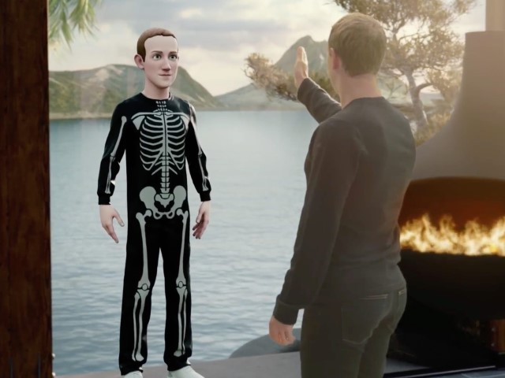
META'S METAVERSE PLANS
In 2021, Mark Zuckerberg changed name of his company from Facebook to Meta indicating his focus on shaping the future of metaverse.
Meta has spent over $36 Billion on research of Metaverse.
3D spaces in the metaverse will let us socialize, learn, collaborate and play in ways that go beyond what we can imagine.
The metaverse will be a collective project that goes beyond a single company. It will be created by people all over the world, and open to everyone.
Wearable technology like smart glasses, virtual reality like Quest and Augmented Reality like Spark AR.

Slide 13
04. APPLICATION OF METAVERSE IN VIDEO GAME INDUSTRY

Slide 14
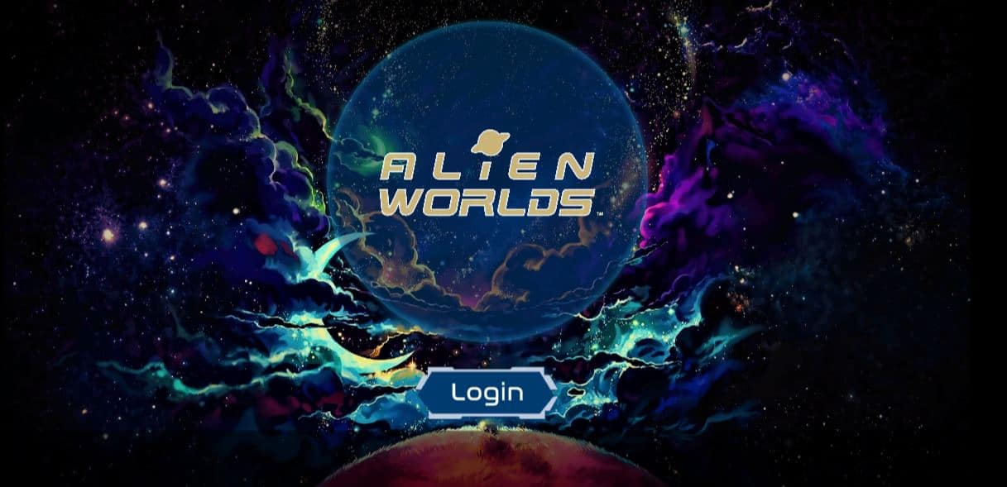
VIDEO GAMES DEVELOPED ON THE CONCEPT OF METAVERSE
1.ALIEN WORLDS:
Launched in 2020, Alien Worlds tasks you to mine Trilium—the official in-game currency from six planets as a space explorer. Each planet has its own elected government and your “voting rights” depend on how much TLM you stake on a planet. You get a shovel to start playing but to get more TLM and powerful mining tools, it’s best to buy your own land, or you can pay a landowner to start excavating. Battling other explorers and going on mining missions can also earn you tokens.

Slide 15
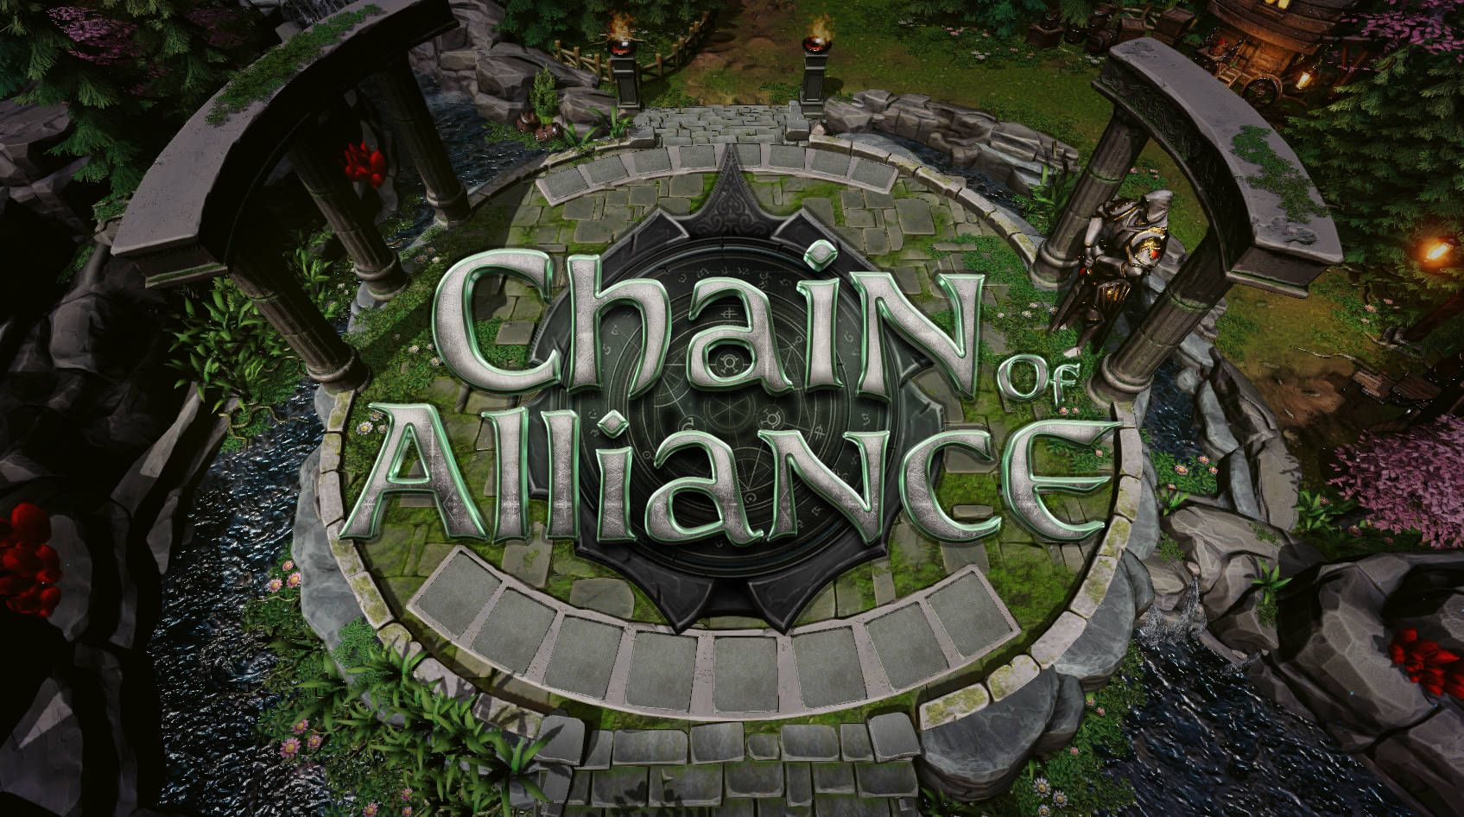
VIDEO GAMES DEVELOPED ON THE CONCEPT OF METAVERSE
2.Chain of alliance:
Chain of Alliance, first released in 2020, is another role-playing fantasy game involving customizable monsters with NFT value. You have to field up to eight characters in your team per round. To raise your winning opportunity, you should determine the best players and arm them with the best weapons.

Slide 16

VIDEO GAMES DEVELOPED ON THE CONCEPT OF METAVERSE
3.ILLUVIUM:
The soon-to-be-released Illuvium is causing a lot of buzz in the gaming world, which describes it as a “true triple-A, 3D blockchain” game. In this game, you hunt for deity-like creatures called illuvials on this alien landscape, capture them using shards, or nurse them back to health. These creatures can then help you fight other players and monsters, which number over a hundred. Illuvials are also tradable NFTs—the stronger and rarer they are, the higher their value becomes. Once you have three of the same illuvial, you can fuse or merge them into one new creature—and raise their value—if each of them has reached its highest level through combat.

Slide 17
05. Future of metaverse

Slide 18
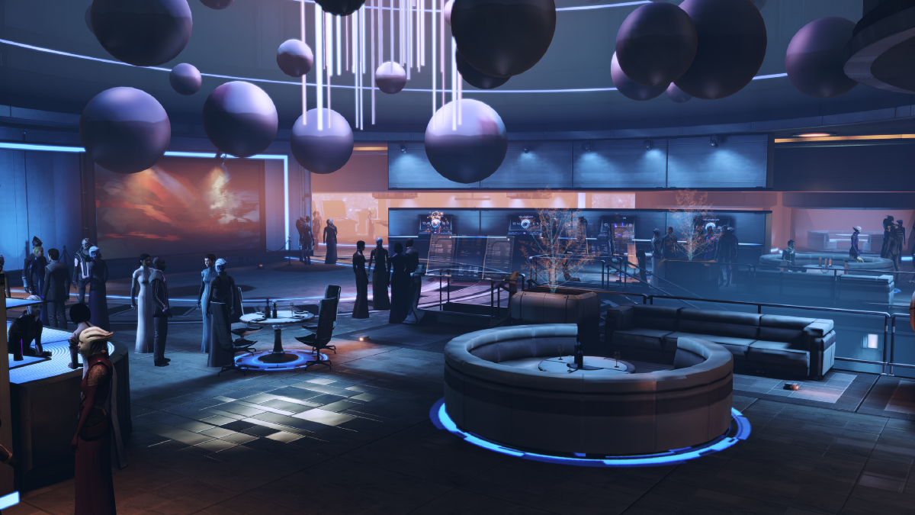
Some Predictions for How the Metaverse Will Impact Our Lives
We will begin to express ourselves in new and exciting ways: Every person will have a character that represents themselves in the Metaverse called an avatar. We will learn how to express pieces of ourselves through these avatars in ways that we may not have been able to test out before.
Our mental health will be impacted: This could have both a positive and a negative impact on our mental health as we are living in two worlds. As with any new technology, we will need to be mindful about not disconnecting ourselves so much from our real life that it becomes difficult to navigate them at the same time.

Slide 19
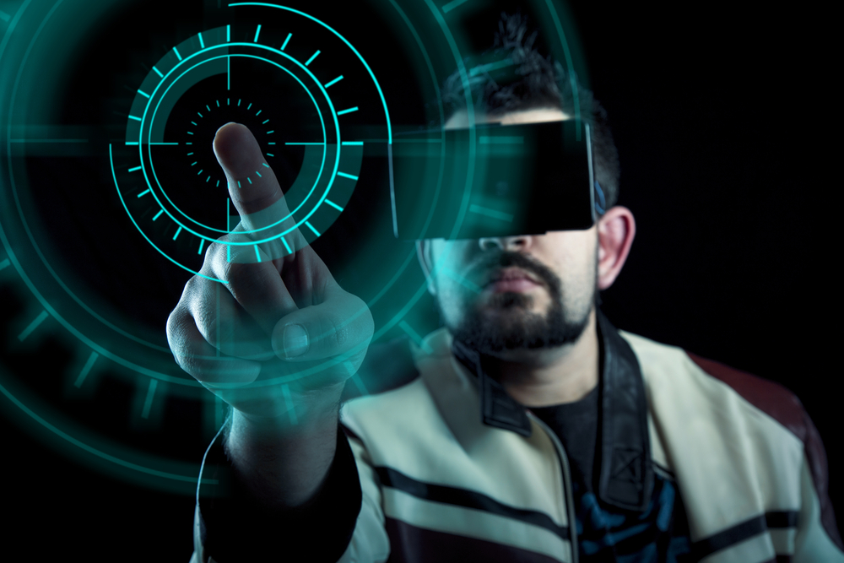
Some Predictions for How the Metaverse Will Impact Our Lives
We may experience dissonance between reality and the metaverse: Let's face it, living in a world where I can have whatever I want, whenever I want it sounds like a dream. But it will also come with some downsides. Going from a Metaverse built around a real-time experience and then going back into reality where things tend to manifest slower will be a bit of a shock to the system. So much so that it could lead to people disconnecting from their real life in favor of the world they've created in the Metaverse. Or it could simply be disorienting to bounce back and forth between the two experiences. We are going to have to learn how to navigate both worlds at the same time.
We will create our collaborative work environment: Work environments will take on a whole new meaning in the metaverse. There will be no limit to the environments we can create. There will be no barriers between environments as we can simply shift between them.

Slide 20
06. PROS AND CONS OF METAVERSE
Pros of Metaverse:
Traveling the world without moving.
Increasing technological literacy and skills.
Connecting with new people without feeling awkward. Creating completely new job opportunities.
Cons of Metaverse:
Required of Advanced Digital Technologies.
Privacy and Security Implications.
Reducing the Difference between Real and Virtual

Slide 21
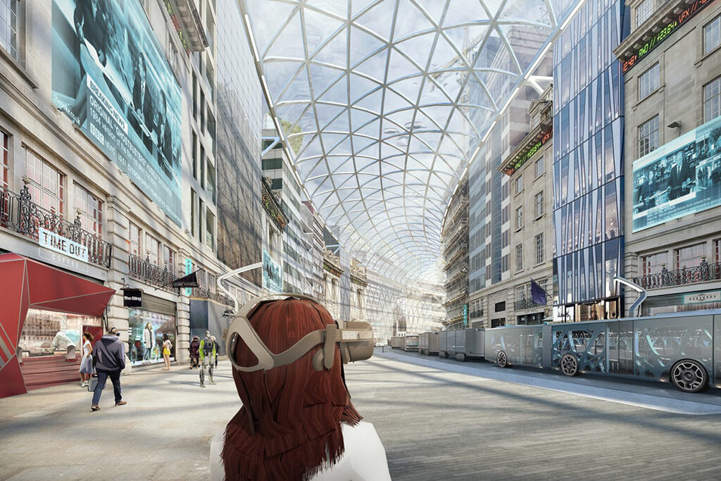
Will virtual reality/AR help improve our imagination and creativity, or just make us more addicted to screens?
The concept of VR headset is very good as it allows you to experience virtual reality in a better way. But this is a very unhealthy practice. First of all it damages our eyes alot.
Secondly it is just promoting more and more isolation of a person and allows him to enter or fantasize about a world which does not exist. It will not be a bad thing if we use it occasionally.

Slide 22
07. references
https://www.businessinsider.in/
Virtual reality – Wikipedia
Top 10 Metaverse Games to Immerse Yourself Into (2023) (influencermarketinghub.com)
https://www.blockchaingamer.biz/wp-content/uploads/2021/03/illuvium-art.jpg
https://media.breitbart.com/media/2021/10/facebook-meta-name-change-mark-zuckerberg.jpg
https://blog.chromia.com/content/images/2020/06/coa_banner.jpg
https://nftevening.com/wp-content/uploads/2021/08/Featuredqqq.jpg

Slide 23
THANK YOU !!!

